Slide 1
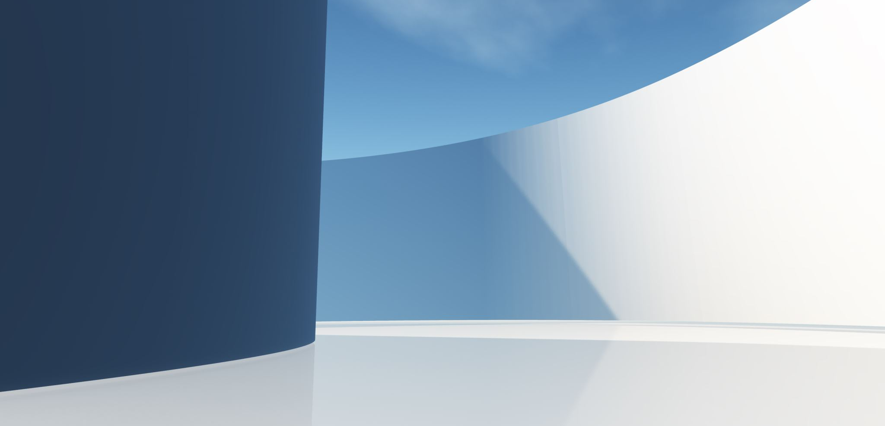
Hand Gesture Recognition
Aditya Saini

Slide 2
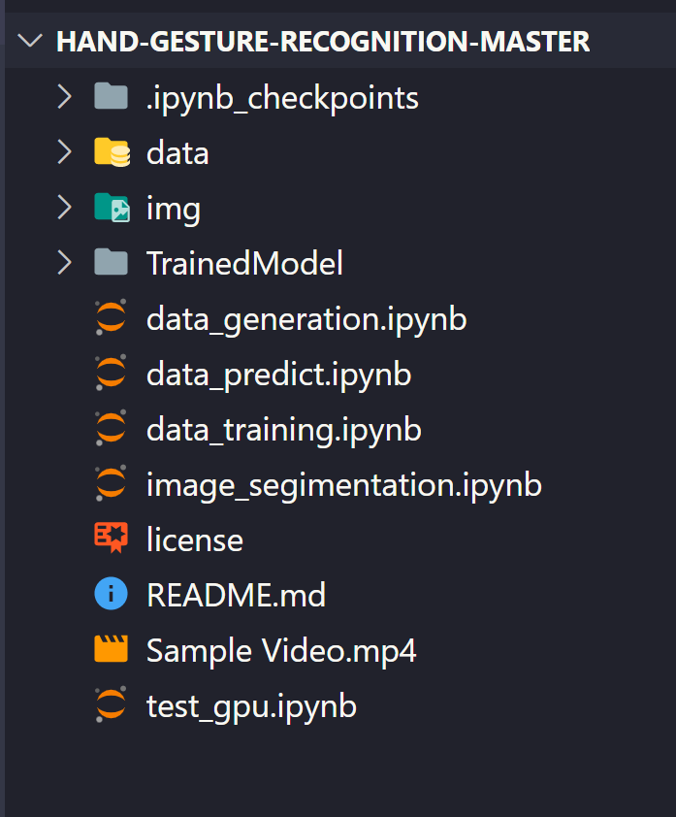
Directory Structure

Slide 3
Modules
Save Points

Slide 4
Modules
Hand Image Dataset

Slide 5
Modules
Images in README.md

Slide 6
Modules
Saved Model

Slide 7
Modules
Source Code

Slide 8
Modules

Slide 9
Modules

Slide 10
Modules

Slide 11
Modules

Slide 12
Modules

Slide 13
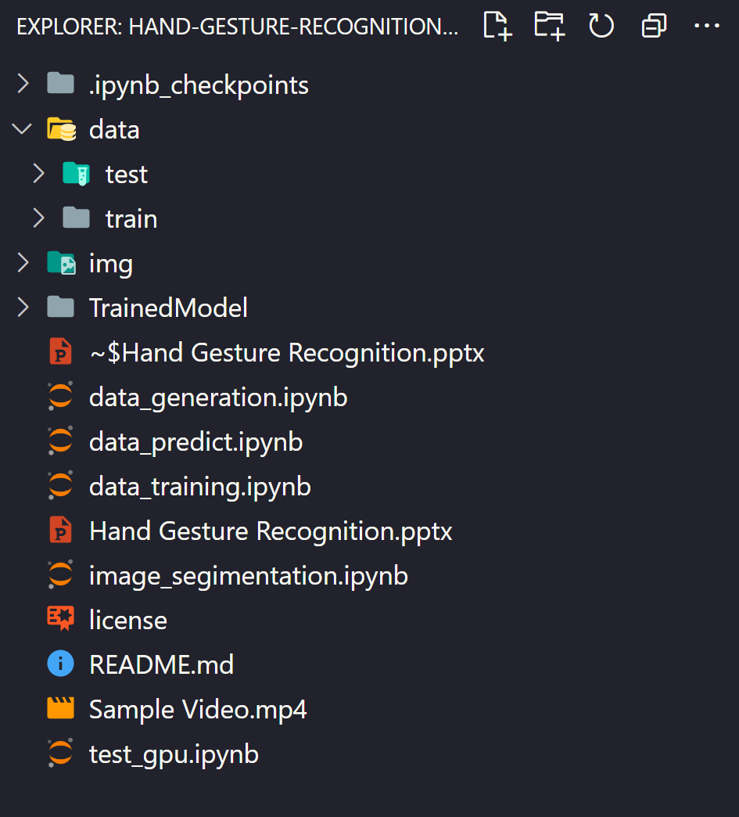
Dataset

Slide 14
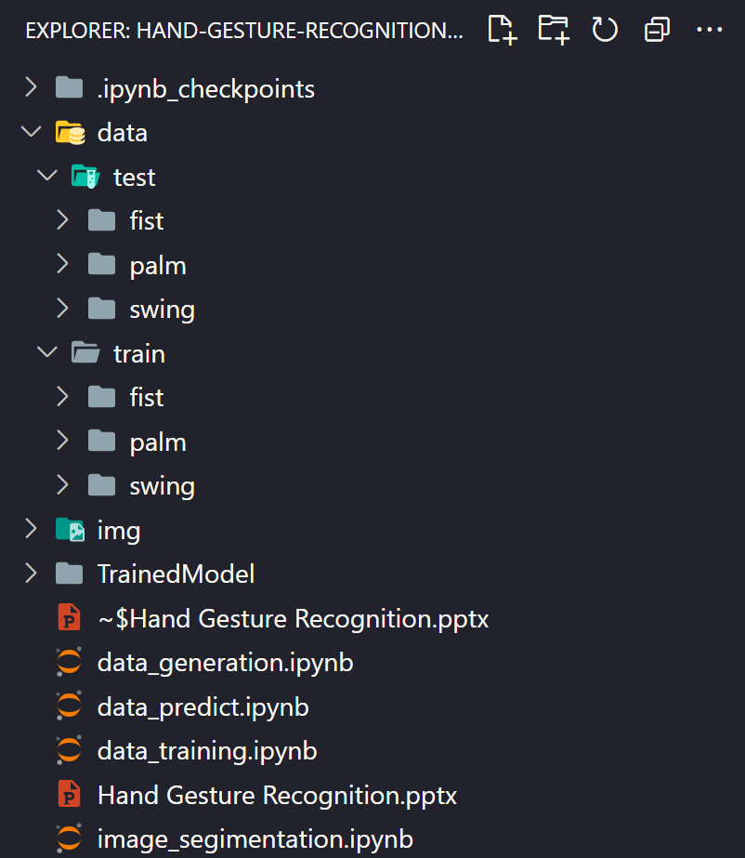



Dataset

